Slide 1
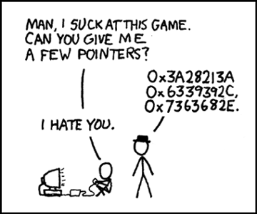

Slide 2
Pointer Review Dynamic Memory Allocation
Zybooks Chapter 2 – Chapter 8.1 8.2

Slide 3
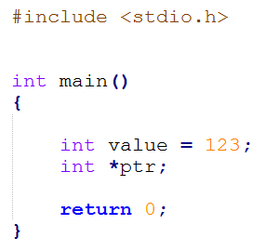
Pointers
A variable that contains a memory address
Typically denoted with an asterisk (*)
Integer
Integer Pointer

Slide 4
Pointers
Reference Operator (&) – gets the variables address
Dereference Operator (*) – gets the data to which the variable points

Slide 5
Pointers
0x28ff24
0x28ff28
0x28ff2c
0x28ff2e
0x28ff30
0x28ff32
0x28ff34

Slide 6
Pointers
int value = 123;
0x28ff24
0x28ff28
0x28ff2c | 123 | value
0x28ff2e
0x28ff30
0x28ff32
0x28ff34

Slide 7
Pointers
int value = 123;
int *ptr;
0x28ff24
0x28ff28 |  | ptr
0x28ff2c | 123 | value
0x28ff2e
0x28ff30
0x28ff32
0x28ff34

Slide 8
Pointers
int value = 123;
int *ptr;
ptr = &value;
0x28ff24
0x28ff28 | 0x28ff2c | ptr
0x28ff2c | 123 | value
0x28ff2e
0x28ff30
0x28ff32
0x28ff34

Slide 9
Pointers
int value = 123;
int *ptr;
ptr = &value;
cout << *prt;
STD:: cout
0x28ff24
0x28ff28 | 0x28ff2c | ptr
0x28ff2c | 123 | value
0x28ff2e
0x28ff30
0x28ff32
0x28ff34

Slide 10
Fun with Pointers
Example: int myVal = 12 at memory addr 99 and int* myPtr at memory addr 44
What does
cout << myVal; output?

Slide 11
Fun with Pointers
Example: int myVal = 12 at memory addr 99 and int* myPtr at memory addr 44
What does
cout << myVal; output?
43
44
45
…
98
99
100

Slide 12
Fun with Pointers
Example: int myVal = 12 at memory addr 99 and int* myPtr at memory addr 44
What does
cout << myVal; output?
43
44 | 99 | myPtr
45
…
98
99 | 12 | myVal
100

Slide 13
Fun with Pointers
Example: int myVal = 12 at memory addr 99 and int* myPtr at memory addr 44
What does
cout << myVal; output?
12
43
44 | 99 | myPtr
45
…
98
99 | 12 | myVal
100

Slide 14
Fun with Pointers
Example: int myVal = 12 at memory addr 99 and int* myPtr at memory addr 44
What does
cout << &myVal; output?
43
44 | 99 | myPtr
45
…
98
99 | 12 | myVal
100

Slide 15
Fun with Pointers
Example: int myVal = 12 at memory addr 99 and int* myPtr at memory addr 44
What does
cout << &myVal; output?
99
43
44 | 99 | myPtr
45
…
98
99 | 12 | myVal
100

Slide 16
Fun with Pointers
Example: int myVal = 12 at memory addr 99 and int* myPtr at memory addr 44
What does
cout << *myVal; output?
43
44 | 99 | myPtr
45
…
98
99 | 12 | myVal
100

Slide 17
Fun with Pointers
Example: int myVal = 12 at memory addr 99 and int* myPtr at memory addr 44
What does
cout << *myVal; output?
ERROR
43
44 | 99 | myPtr
45
…
98
99 | 12 | myVal
100

Slide 18
Fun with Pointers
Example: int myVal = 12 at memory addr 99 and int* myPtr at memory addr 44
After myPtr = &myVal
What does
cout << *myPtr; output?
43
44 | 99 | myPtr
45
…
98
99 | 12 | myVal
100

Slide 19
Fun with Pointers
Example: int myVal = 12 at memory addr 99 and int* myPtr at memory addr 44
After myPtr = &myVal
What does
cout << *myPtr; output?
12
43
44 | 99 | myPtr
45
…
98
99 | 12 | myVal
100

Slide 20
Pointer
Use of a pointer in Functions
Instead of passing a full variable and recreating a new instance in memory for a large data type – pass a pointer
Function 1
Function 2
Int
27

Slide 21
Pointer
Use of a pointer in Functions
Instead of passing a full variable and recreating a new instance in memory for a large data type – pass a pointer
27
Function 1
Function 2
Int
27

Slide 22
Pointer
Use of a pointer in Functions
Instead of passing a full variable and recreating a new instance in memory for a large data type – pass a pointer
27
Function 1
Function 2
Int
27
Int
27

Slide 23
Pointer
Use of a pointer in Functions
Instead of passing a full variable and recreating a new instance in memory for a large data type – pass a pointer
Function 1
Function 2
Does Some Stuff
Int
27
Int
48

Slide 24
Pointer
Use of a pointer in Functions
Instead of passing a full variable and recreating a new instance in memory for a large data type – pass a pointer
Function 1
Function 2
Does Some Stuff
Int
27
Int
48
48

Slide 25
Pointer
Use of a pointer in Functions
Instead of passing a full variable and recreating a new instance in memory for a large data type – pass a pointer
Function 1
Function 2
Does Some Stuff
Int
48
Int
48
48

Slide 26
Pointer
Use of a pointer in Functions
Instead of passing a full variable and recreating a new instance in memory for a large data type – pass a pointer
Function 1
Function 2
Int
27

Slide 27
Pointer
Use of a pointer in Functions
Instead of passing a full variable and recreating a new instance in memory for a large data type – pass a pointer
& = 44
Function 1
Function 2
Int
27

Slide 28
Pointer
Use of a pointer in Functions
Instead of passing a full variable and recreating a new instance in memory for a large data type – pass a pointer
& = 44
Function 1
Function 2
Int
27
44

Slide 29
Pointer
Use of a pointer in Functions
Instead of passing a full variable and recreating a new instance in memory for a large data type – pass a pointer
& = 44
Function 1
Function 2
Int
27
*
44

Slide 30
Pointer
Use of a pointer in Functions
Instead of passing a full variable and recreating a new instance in memory for a large data type – pass a pointer
Function 1
Function 2
Int
27
*
48
44

Slide 31
Pointer
Use of a pointer in Functions
Instead of passing a full variable and recreating a new instance in memory for a large data type – pass a pointer
Function 1
Function 2
Does some Stuff
Int
48
*
48
44

Slide 32
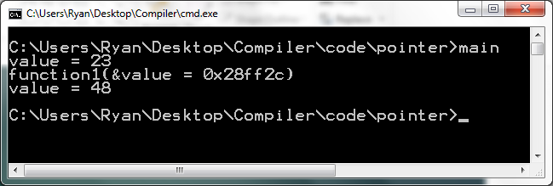
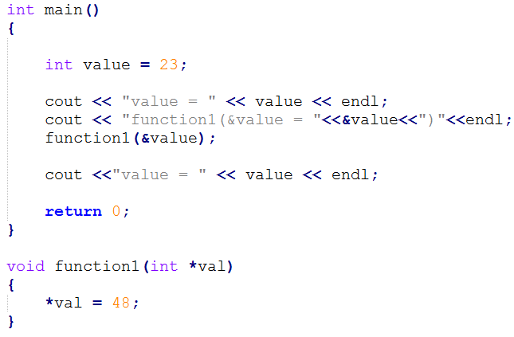
Pointer
Use of pointer in functions
Passes address
Accepts Pointer

Slide 33
Dynamic Memory Allocation
Dynamic Allocation – the means by which a program can obtain memory WHILE it is running.
WHY? – some data structures are dynamic (Trees, Queues, Stacks, Heaps) and the storage needs aren’t known ahead of time.
Allocated using the operator new
Variable:
pointer = new type;
Arrays:
pointer = new type [number_of_elements];

Slide 34
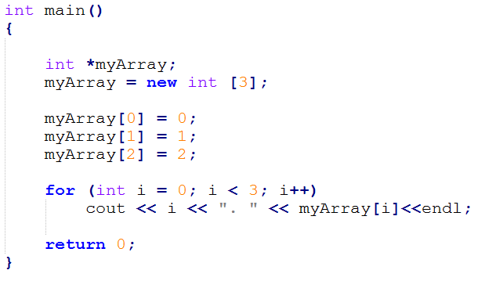
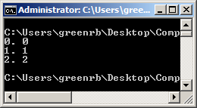
Dynamic Memory Allocation

Slide 35
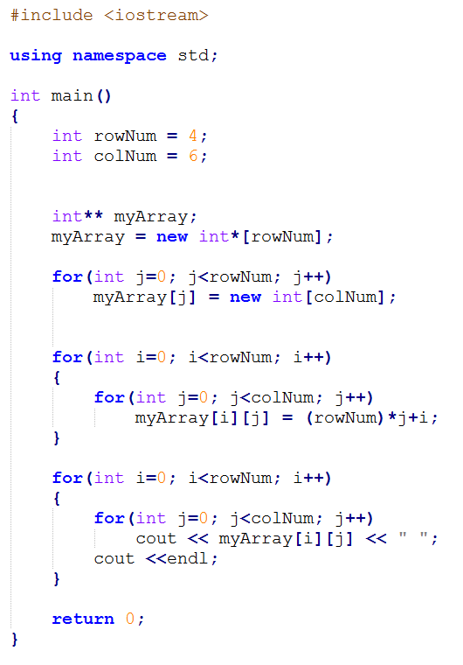
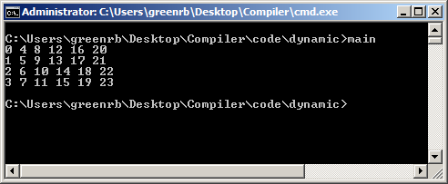
Dynamic Memory Allocation
Allocate Rows
Allocate Columns

Slide 36
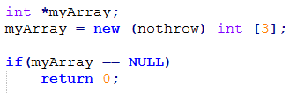
Dynamic Memory Allocation
new – if the allocation fails it throws something called an exception (We’ll learn this later). For now add (nothrow) between new and type.
You can check if the allocation fails by checking the pointer == NULL

Slide 37
Dynamic Memory Allocation
delete – the opposite of new
Deallocates a memory block pointed to by a pointer
NOTE: in order for delete to work, the pointer has to have been previously used to allocate via new.
myArray = new (nothrow) int [3];
… stuff …
delete myArray;

Slide 38
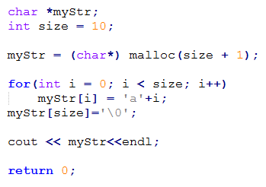
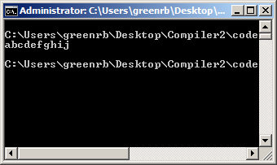
Dynamic Memory Allocation
malloc(size) – allocates a block of size of memory. New content is not initialized.

Slide 39
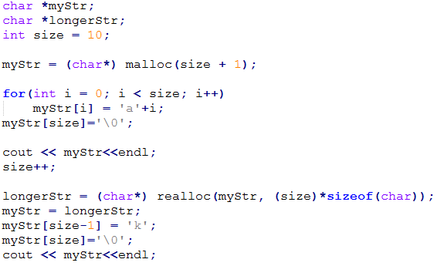
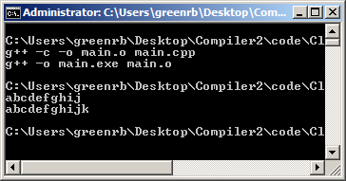
Dynamic Memory Allocation
realloc(ptr, size) – changes the size of the memory block pointed to by ptr

Slide 40
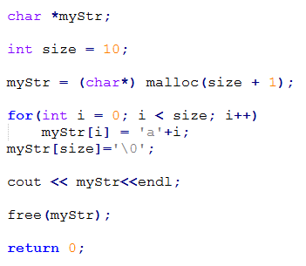
Dynamic Memory Allocation
free(ptr) – makes memory available that has been previously allocated by malloc and realloc.

